Slide 1
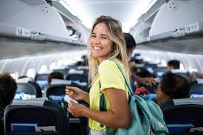
Airline Passenger Satisfaction
Reda Ibrahim LinkedIn

Slide 2
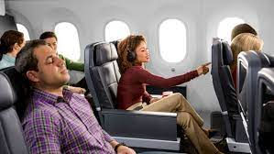
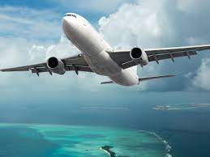
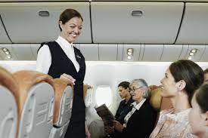
Data
Passenger
Flight
Gender, Age, Type of airline customer, Purpose of the flight, and Travel class
Services
aftr
Flight distance, Flight departure delay
Flight arrival delay, Departure and Arrival Time Convenience
Ease of Online Booking, Online Booking, Check-in Service, Online Boarding, Seat Comfort, Cleanliness, Food and Drink, In-flight Service, In-flight Wi-Fi Service, Baggage Handling, In-flight Entertainment

Slide 3

What is our Dataset
129888 Row & 24 Columns
Smallest passenger has 7 years
Oldest passenger has 85 years
Let’s Know More

Slide 4
Continue
15 Minute
Type of Travel
Class
Customer Type
Business 89693
Personal 40187
Business 62160
Economy 58309
Economy Plus 9411
Arrival Delay
First Time 23780
Returning 106100

Slide 5

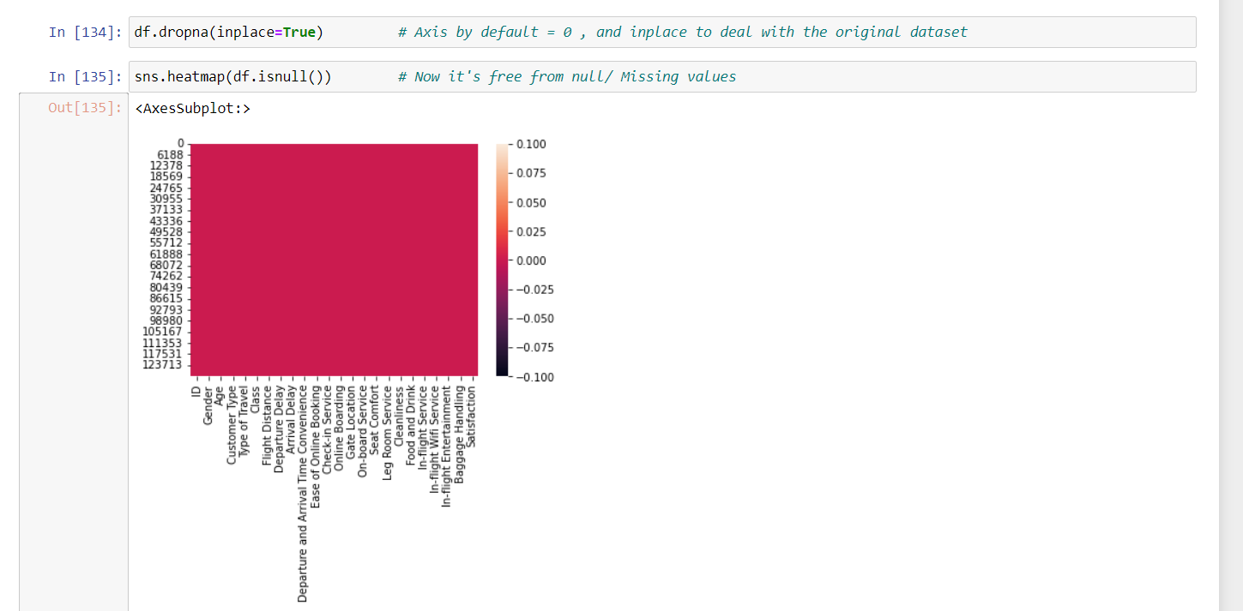

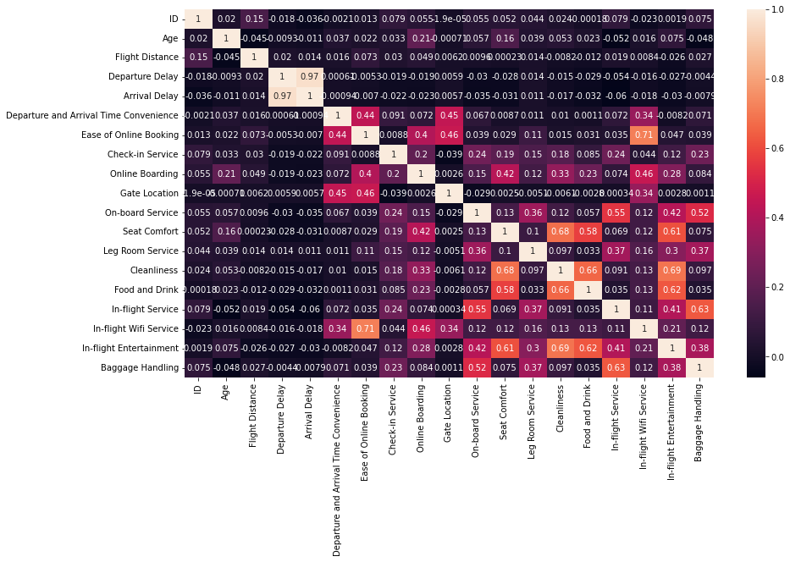
Data Preprocessing
Missing Values
Outliers
Duplicated Values
Notes:
<a href="https://www.freepik.com/free-vector/blue-abstract-technology-background_4666670.htm#query=background%20future&position=10&from_view=search&track=sph">Image by pikisuperstar</a> on Freepik

Slide 6
Question & EDA / Exploratory Data Analysis
56%
44%
56.55%
How many Flights that There is no Arrival Delay and What is it's Percentage
Arrival Delay and What is it's Percentage
Overall Satisfaction Percentage That is Satisfied
50.74% Female
47.87%
7.42%
81.69%
Gender Female and Male
Class Type Business
Class Type Economic Plus
Customer Type Returning
Notes:
<a href="https://www.freepik.com/free-vector/blue-abstract-technology-background_4666670.htm#query=background%20future&position=10&from_view=search&track=sph">Image by pikisuperstar</a> on Freepik

Slide 7
Insights
Baggage Handling
Baggage Handling Satisfaction Level
The demographic profile
What is the demographic profile of passengers who are most satisfied with the airline flight ?
Type of the customer
How does the satisfaction level vary based on the type of customer ?
Notes:
<a href="https://www.freepik.com/free-vector/blue-abstract-technology-background_4666670.htm#query=background%20future&position=10&from_view=search&track=sph">Image by pikisuperstar</a> on Freepik
Photo by Yuyeung Lau on Unsplash

Slide 8
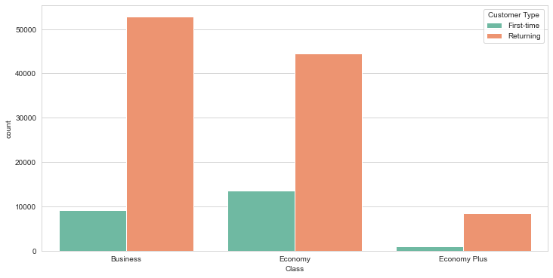
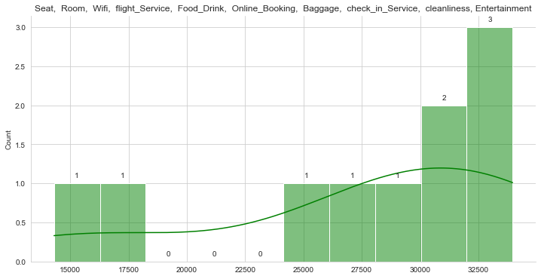
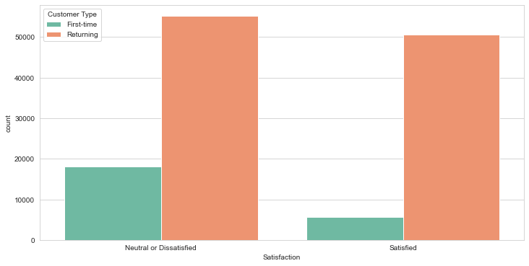
Continue
Satisfaction Levels according to different pillars
Notes:
<a href="https://www.freepik.com/free-vector/electronic-health-record-technology_16367369.htm#query=ai%20Medic&position=21&from_view=search&track=sph">Image by rawpixel.com</a> on Freepik
Photo by Accuray on Unsplash

Slide 9



Recommendations
1- Provide services and facilities that cater to the needs and preferences of different passenger classes, such as offering more spacious and comfortable seats for passengers traveling in higher class, and providing different entertainment options that suit different ages and nationalities.
2- Develop training programs for the airline crew to increase awareness of cultural and gender diversity among passengers, and to improve their communication and interaction skills with them.
3- Improve the quality of service provided to passengers overall, including improving the food and beverage service and providing regular cleaning and maintenance services for the aircraft.
4- Improve the boarding and disembarking process, by providing quick and flexible check-in procedures, improving security screening procedures, and providing necessary support for passengers with special needs.
5- Collect more data and analyze it regularly to improve services and better meet the needs of passengers.
Notes:
<a href="https://www.freepik.com/free-photo/robot-writing-with-pen_958109.htm#query=robot%20education&position=12&from_view=search&track=sph">Image by kjpargeter</a> on Freepik
Photo by Umberto on Unsplash
Photo by Alexandre Van Thuan on Unsplash

Slide 10


Reda Ibrahim
Thank You
Notes:
<a href="https://www.freepik.com/free-vector/futuristic-artificial-intelligence-face-technology-background_4402943.htm#query=ai&position=45&from_view=search&track=sph">Image by starline</a> on Freepik

